Slide 1
MA3077 Operational Research Lecture 2 – linear programming and linear modelling
Dr Marco Fasondini

Slide 2
Lecture outline
Today's goal is to:
learn how to write a linear programming problem in standard form,
and learn how some nonlinear functions can be modelled with linear functions.
Today's lecture is loosely based on chapter 2.2 of the Mosek Cookbook

Slide 3
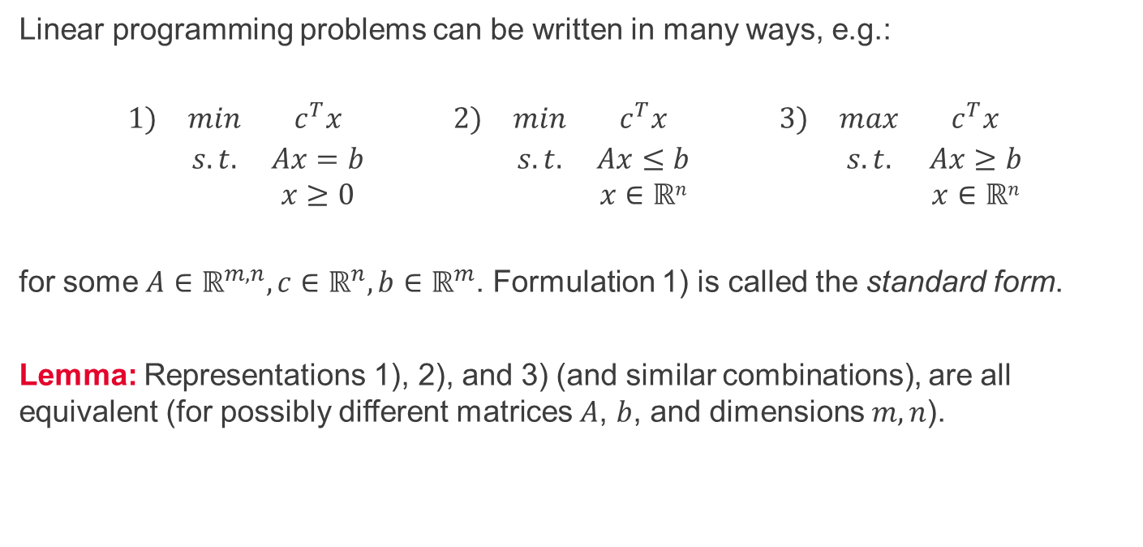
Linear programming in standard form
Linear programming problems can be written in many ways, e.g.:
$$\begin{matrix}1) & min & c^{T}x & & 2) & min & c^{T}x & & 3) & max & c^{T}x \\ & s.t. & Ax=b & & & s.t. & Ax≤b & & & s.t. & Ax≥b \\ & & x≥0 & & & & x∈ℝn & & & & x∈ℝn\end{matrix}$$
for some $A∈ℝ^{m,n}, c∈ℝ^{n}, b∈ℝ^{m}$. Formulation 1) is called the standard form.
Lemma: Representations 1), 2), and 3) (and similar combinations), are all equivalent (for possibly different matrices $A$, $b$, and dimensions $m,n$).

Slide 4
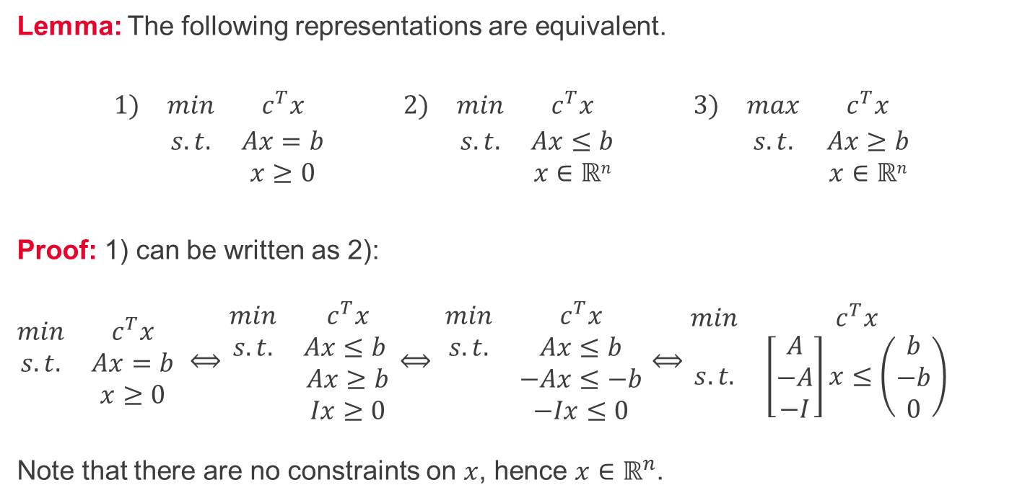
Linear programming in standard form – Proof 1/3
Lemma: The following representations are equivalent.
$$\begin{matrix}1) & min & c^{T}x & & 2) & min & c^{T}x & & 3) & max & c^{T}x \\ & s.t. & Ax=b & & & s.t. & Ax≤b & & & s.t. & Ax≥b \\ & & x≥0 & & & & x∈ℝn & & & & x∈ℝn\end{matrix}$$
Proof: 1) can be written as 2): $\begin{matrix}min & c^{T}x \\ s.t. & Ax=b \\ & x≥0\end{matrix}$ $⟺\begin{matrix}min & c^{T}x \\ s.t. & Ax≤b \\ & Ax≥b \\ & Ix≥0\end{matrix}$ $⟺ \begin{matrix}min & c^{T}x \\ s.t. & Ax≤b \\ & −Ax≤−b \\ & −Ix≤0\end{matrix}$ $⟺$ $\begin{matrix}min & c^{T}x \\ s.t. & \left[\begin{matrix}A \\ −A \\ −I\end{matrix}\right]x≤\left(\begin{matrix}b \\ −b \\ 0\end{matrix}\right)\end{matrix}$ Note that there are no constraints on $x$, hence $x∈ℝ^{n}$.

Slide 5
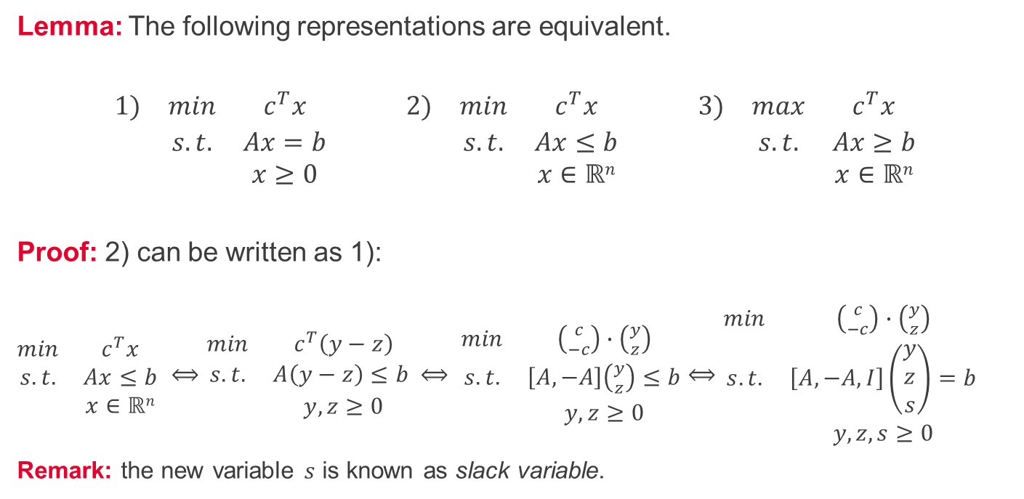
Linear programming in standard form – Proof 2/3
Lemma: The following representations are equivalent.
$$\begin{matrix}1) & min & c^{T}x & & 2) & min & c^{T}x & & 3) & max & c^{T}x \\ & s.t. & Ax=b & & & s.t. & Ax≤b & & & s.t. & Ax≥b \\ & & x≥0 & & & & x∈ℝn & & & & x∈ℝn\end{matrix}$$
Proof: 2) can be written as 1): $\begin{matrix}min & c^{T}x \\ s.t. & Ax≤b \\ & x∈ℝn\end{matrix}$ $⟺\begin{matrix}min & c^{T}\left(y−z\right) \\ s.t. & A\left(y−z\right)≤b \\ & y, z≥0\end{matrix}$ $⟺ \begin{matrix}min & \left({c \atop −c}\right)∙\left({y \atop z}\right) \\ s.t. & \left[A, −A\right]\left({y \atop z}\right)≤b \\ & y, z≥0\end{matrix}$ $⟺\begin{matrix}min & \left({c \atop −c}\right)∙\left({y \atop z}\right) \\ s.t. & \left[A, −A, I\right]\left(\begin{matrix}y \\ z \\ s\end{matrix}\right)=b \\ & y, z,s≥0\end{matrix}$
Remark: the new variable $s$ is known as slack variable.

Slide 6
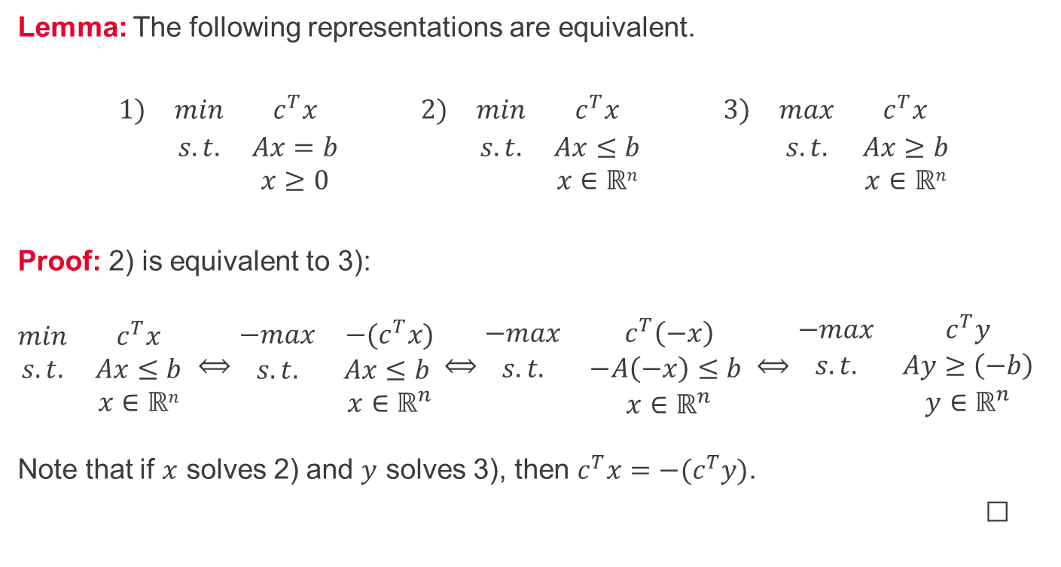
Linear programming in standard form – Proof 3/3
Lemma: The following representations are equivalent.
$$\begin{matrix}1) & min & c^{T}x & & 2) & min & c^{T}x & & 3) & max & c^{T}x \\ & s.t. & Ax=b & & & s.t. & Ax≤b & & & s.t. & Ax≥b \\ & & x≥0 & & & & x∈ℝn & & & & x∈ℝn\end{matrix}$$
Proof: 2) is equivalent to 3): $\begin{matrix}min & c^{T}x \\ s.t. & Ax≤b \\ & x∈ℝn\end{matrix}$ $⟺\begin{matrix}−max & {−(c}^{T}x) \\ s.t. & Ax≤b \\ & x∈ℝ^{n}\end{matrix}$ $⟺\begin{matrix}−max & c^{T}\left(−x\right) \\ s.t. & −A\left(−x\right)≤b \\ & x∈ℝ^{n}\end{matrix}⟺\begin{matrix}−max & c^{T}y \\ s.t. & Ay≥\left(−b\right) \\ & y∈ℝ^{n}\end{matrix}$ Note that if $x$ solves 2) and $y$ solves 3), then $c^{T}x=−(c^{T}y)$.
☐

Slide 7
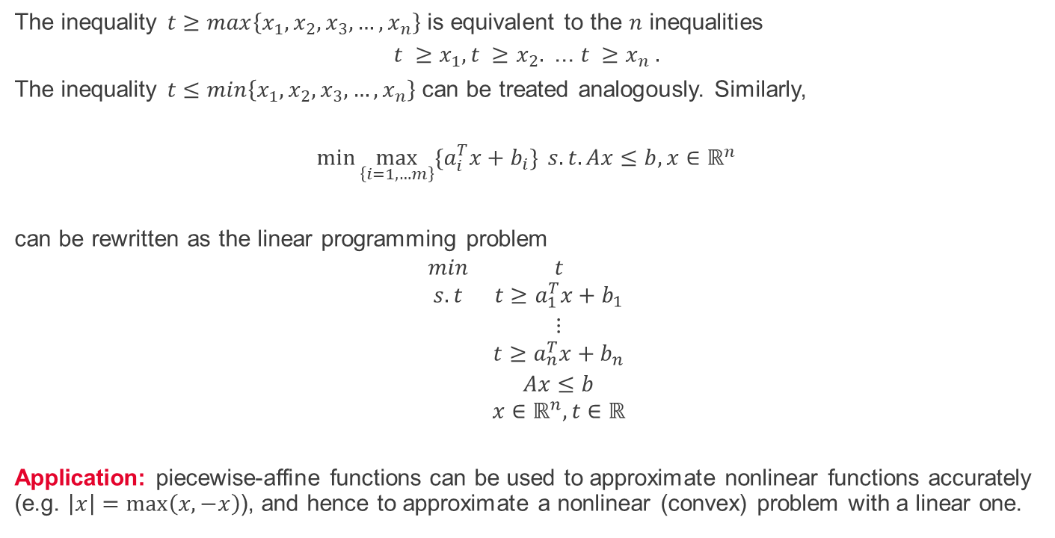
Linear modelling - maximum
The inequality $t≥max\left\{x_{1},x_{2},x_{3},…,x_{n}\right\}$ is equivalent to the $n$ inequalities
$$t ≥x_{1},t ≥x_{2}.\text{ ... }t ≥x_{n} .$$
The inequality $t≤min\left\{x_{1},x_{2},x_{3},…,x_{n}\right\}$ can be treated analogously. Similarly,
$$\min{\max_{\left\{i=1,…m\right\}}{{\{a}_{i}^{T}x+b_{i}\}}} s.t.Ax≤b, x∈ℝ^{n}$$
can be rewritten as the linear programming problem
$$\begin{matrix}min & t \\ s.t & t≥a_{1}^{T}x+b_{1} \\ & ⋮ \\ & t≥a_{n}^{T}x+b_{n} \\ & Ax≤b \\ & x∈ℝ^{n}, t∈ℝ\end{matrix}$$
Application: piecewise-affine functions can be used to approximate nonlinear functions accurately (e.g. $\left|x\right|=\max\left(x, −x\right)$), and hence to approximate a nonlinear (convex) problem with a linear one.

Slide 8
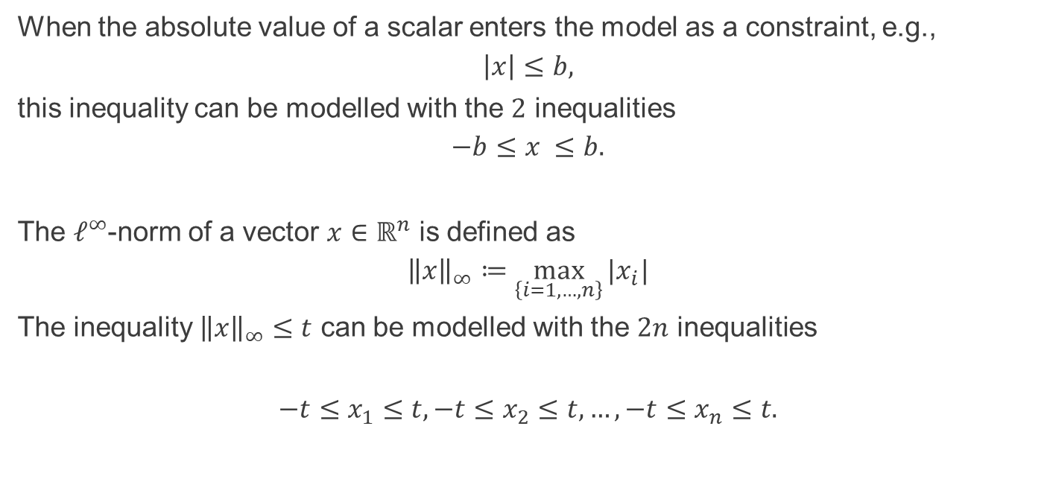
Linear modelling – absolute value and $ℓ^{∞}$-norm
When the absolute value of a scalar enters the model as a constraint, e.g.,
$$\left|x\right|≤b,$$
this inequality can be modelled with the $2$ inequalities
$$−b≤x ≤b.$$
The $ℓ^{∞}$-norm of a vector $x∈ℝ^{n}$ is defined as
$${\left\|x\right\|}_{∞}≔\max_{\left\{i=1, …, n\right\}}{|x_{i}|}$$
The inequality ${\left\|x\right\|}_{∞}≤t$ can be modelled with the $2n$ inequalities
$$−t≤x_{1}≤t,−t≤x_{2}≤t,…,−t≤x_{n}≤t.$$

Slide 9
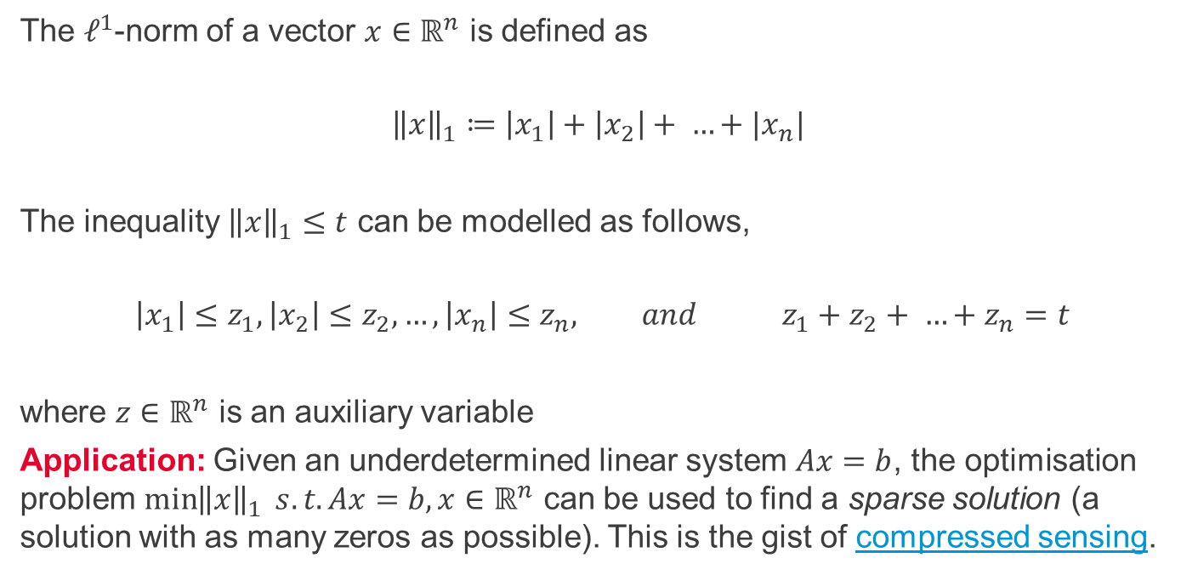
Linear modelling - $ℓ^{1}$-norm
The $ℓ^{1}$-norm of a vector $x∈ℝ^{n}$ is defined as
$${\left\|x\right\|}_{1}≔\left|x_{1}\right|+\left|x_{2}\right|+ …+|x_{n}|$$
The inequality ${\left\|x\right\|}_{1}≤t$ can be modelled as follows,
$$\left|x_{1}\right|≤z_{1},\left|x_{2}\right|≤z_{2},…,\left|x_{n}\right|≤z_{n}, and { z}_{1}+z_{2}+ …+z_{n}=t$$
where $z∈ℝ^{n}$ is an auxiliary variable
Application: Given an underdetermined linear system $Ax=b$, the optimisation problem $\min{{\left\|x\right\|}_{1}} s.t.Ax=b,x∈ℝ^{n}$ can be used to find a sparse solution (a solution with as many zeros as possible). This is the gist of compressed sensing.

Slide 10
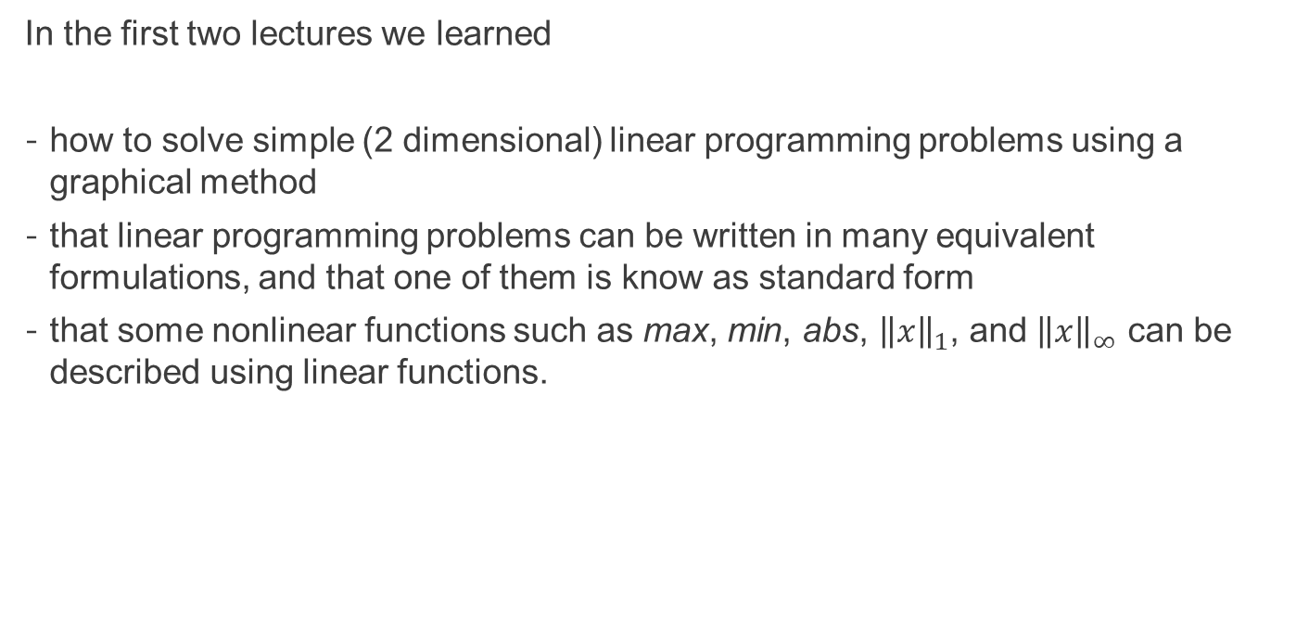
Summary
In the first two lectures we learned
how to solve simple (2 dimensional) linear programming problems using a graphical method
that linear programming problems can be written in many equivalent formulations, and that one of them is know as standard form
that some nonlinear functions such as max, min, abs, ${\left\|x\right\|}_{1}$, and ${\left\|x\right\|}_{∞}$ can be described using linear functions.

Slide 11
Self-study
A farmer owns 80 acres and produces wheat and barley. To produce these crops, the farmer incurs some costs (seeds, fertilisers, etc.). An acre of wheat costs £100, whereas an acre of barley costs £120. To sell the crops at the most favorable market conditions (£1.50 per bushel of wheat and £3.00 per bushel of barley), the farmer stores them in a barn that has capacity for 5'000 bushels. An acre cultivated with wheat produces 115 bushels, whereas an acre allocated to barley produces 35 bushels. Knowing that the farmer currently has £16'000 available for expenses, how should they plant their field?
Create your own (2 dimensional) linear programming problem and solve it using the graphical method. Then, write your example in standard form.

